Slide 1


BUY TO LET PROPERTY
AS AN INVESTMENT
Ray McMahon, Chief Operating Officer, Dilosk
15th November 2018

Slide 2
Contents
Company Background
An Overview of the Irish Mortgage Market
ICS Mortgages Buy-to-Let Proposition

Slide 3
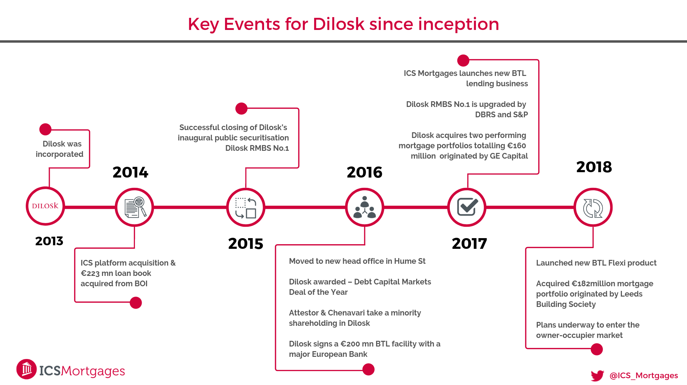


Slide 4
An Overview of the Irish Mortgage Market

Slide 5
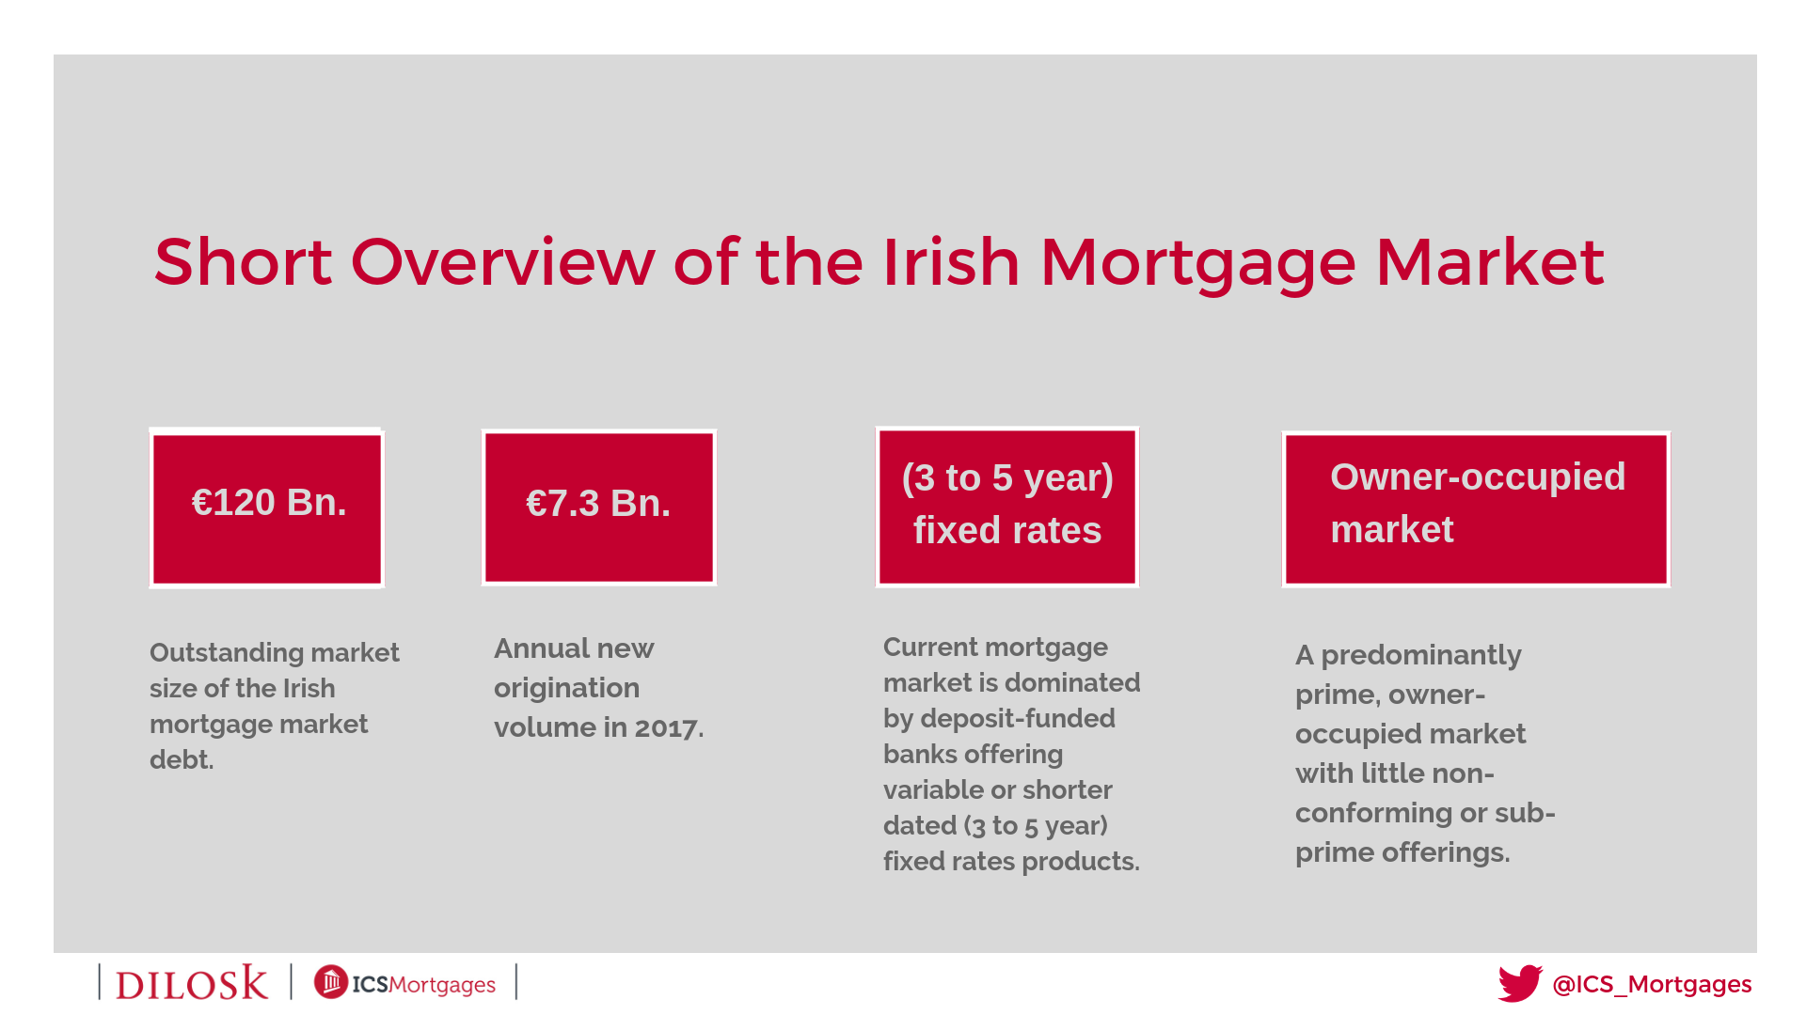


Slide 6
Improved supply has affected house price inflation but not rent inflation

Slide 7
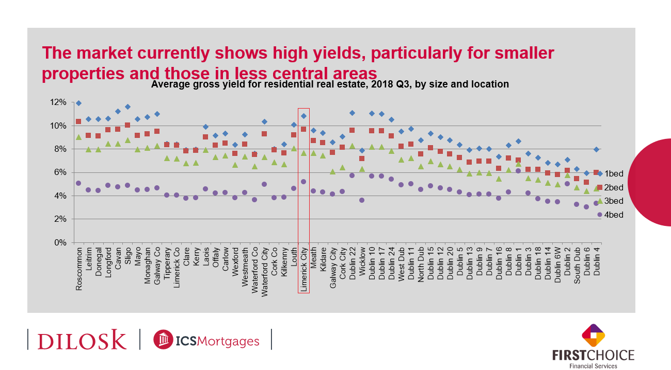
The market currently shows high yields, particularly for smaller properties and those in less central areas

Slide 8
Comparing our stock of dwellings with our population, Ireland has no shortage of houses – rather it’s missing about 500,000 apartments
~30k surplus
~130k surplus
~190k deficit
~340k deficit

Slide 9
The shortfall jumps out when we compare our stock of housing with those in our EU peers
Ireland has just 12% of its dwellings in apartments
– a quarter the EU average

Slide 10
It is not just a backlog – population growth, demographic change and urbanization mean the need for new apartments persists until the 2080s
Addressing current backlog of apts = 25,000 needed per year until 2040
In addition, if…
  Eurostat is right and Ireland’s population reaches 6.2m by 2080 (modest?)
  By then, Ireland is 80% urban and its average household size is 2.2 (modest?)
Then…
  Ireland’s five largest cities will house 5m people, mostly in 1-2 person households
  The country will need 1.9m apartments
One apartment block every week in Dublin until the 2080s

Slide 11
High construction costs mean that, once site costs are factored in, it is simply not viable to build apartments in the vast majority of the Irish market
Source: Analysis of Daft.ie Reports, various industry sources

Slide 12
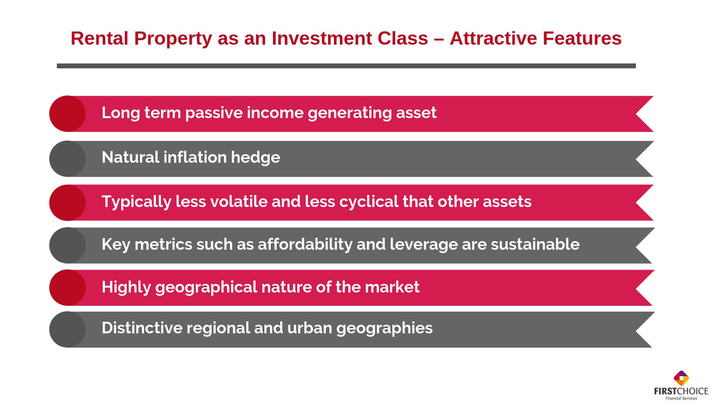
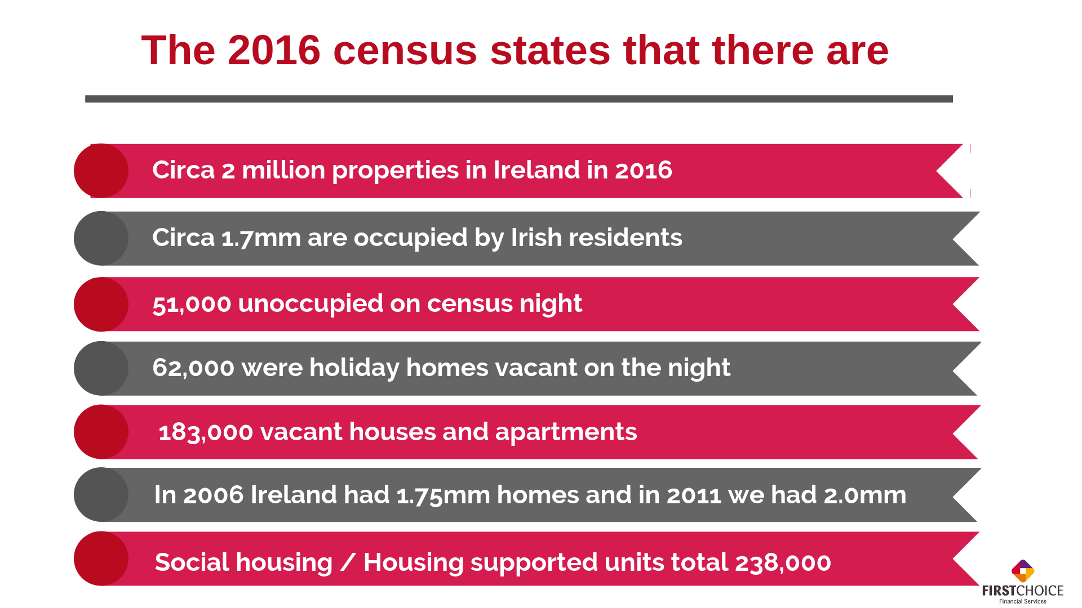
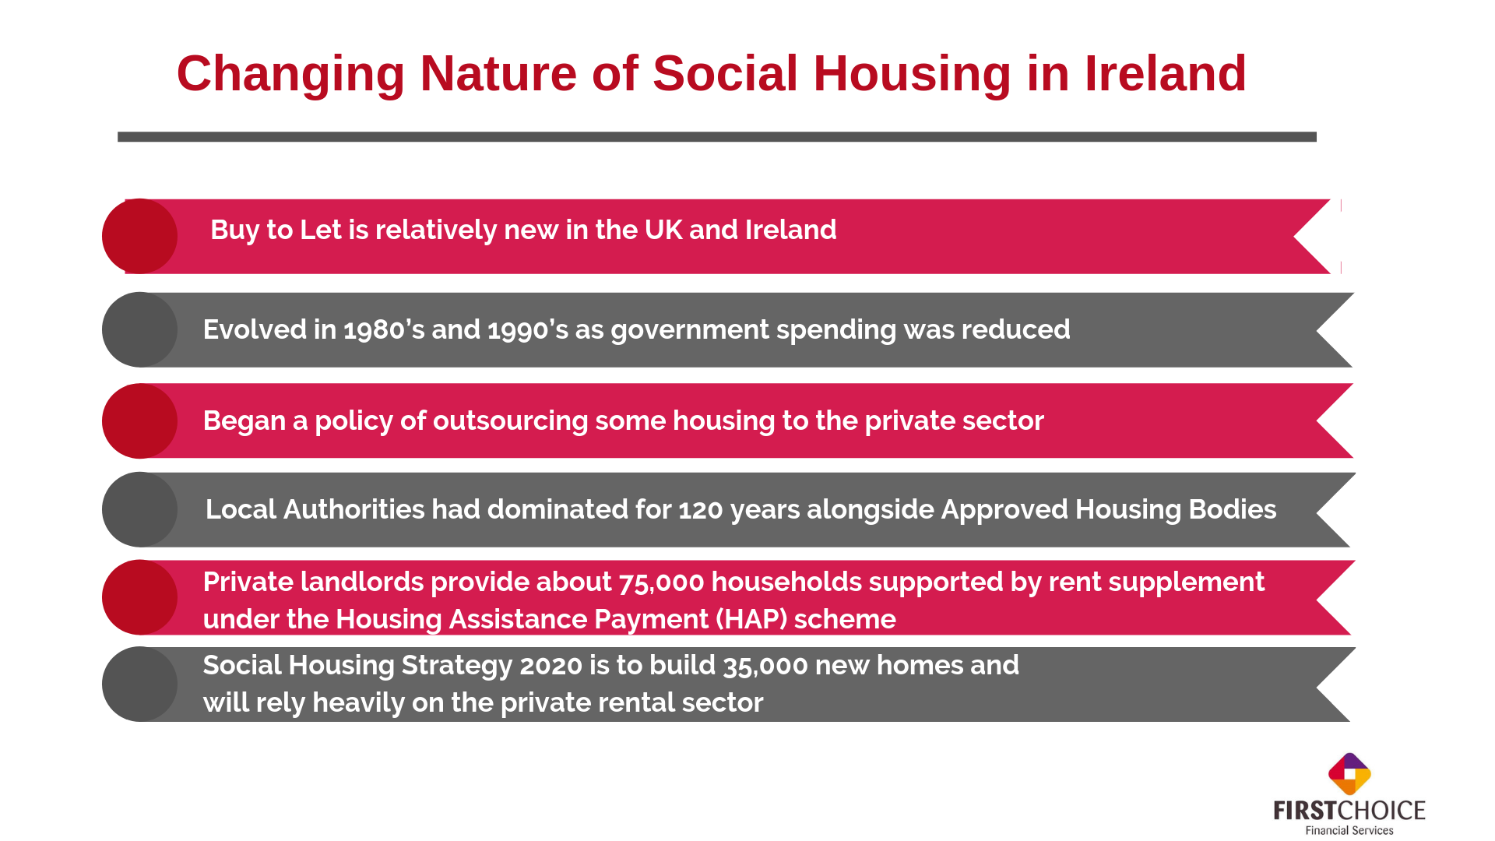

Slide 14
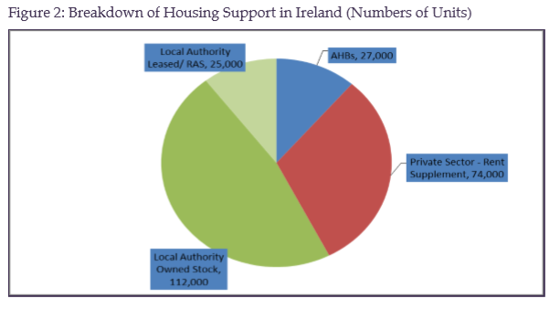

Slide 15
Social and Private Housing Output and Social Housing Sold to Tenants, 1920s –2007.
 | 1920s | 1930s | 1940s | 1950s | 1960s | 1970s | 1980s | 1990s | 2000-07
Social Housing | 6,920 | 38,450 | 20,768 | 52,500 | 29,124 | 61,953 | 42,893 | 20,184 | 46,926
Private Housing | 10,910 | 31,657 | 37164 | 49,188 | 64,835 | 176,230 | 182,203 | 275,186 | 468,318
Social Housing Sold to Tenants |  |  |  |  | 64,490 | 59,566 | 46,204 | 17,024 | 10,649

Slide 16
2006 the sector accommodated 11 per cent of Irish households, 75 per cent of its dwellings were procured and managed directly by local authorities and practically all funding was derived from direct government grants (Central Statistics Office, 2006).
Mid-1980s, the role of social housing in Ireland changed and following radical cutbacks in funding and output
Spending on this sector was cut back severely in the mid-1980s, and new build fell from 7,002 units in 1984 to 768 in 1989.
The proportion of households living in this tenure fell from 15.7 per cent in 1971 to 6.9 per cent in 2002, while households with incomes below 60 per cent of the national median grew from 59 to 75 per cent of the social housing tenant population between 1987 and 1994.
The number of claimants grew by 107 per cent between 1994 and 2005

Slide 17
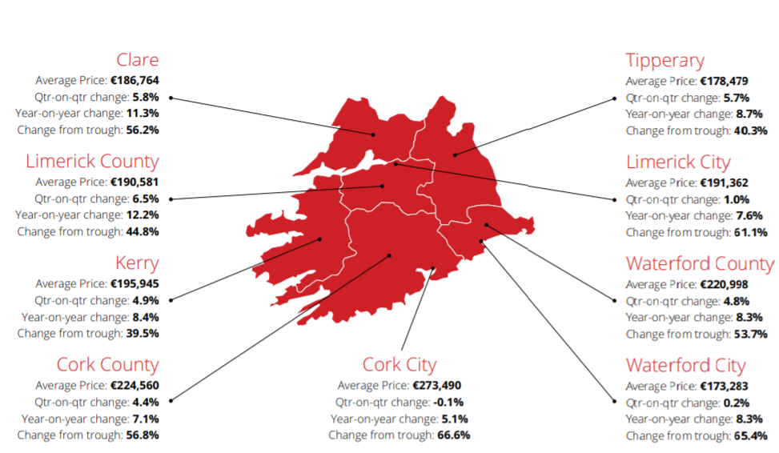
Munster – Price Jumps
Source: The Daft.ie House Price Report for 2018 Q3

Slide 18
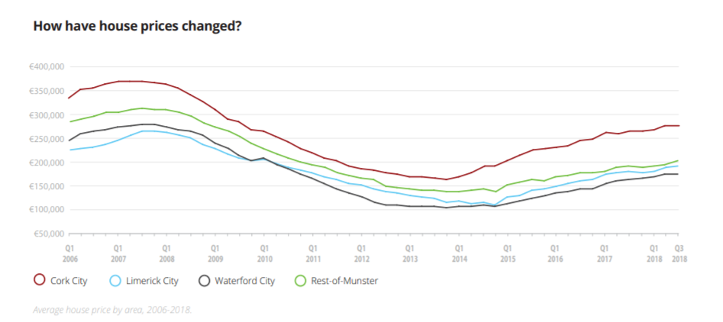
Munster – overview 2018 Q3
7,800 properties on the market for rent in September (3% lower than Sept ‘17)
Prices rose strongly in Q2 ‘18, but in Cork, Limerick and Waterford cities- unchanged in Q3 ’18
Large increases in house prices outside the cities - 4.4% in Cork and 6.5% in Limerick county

Slide 19
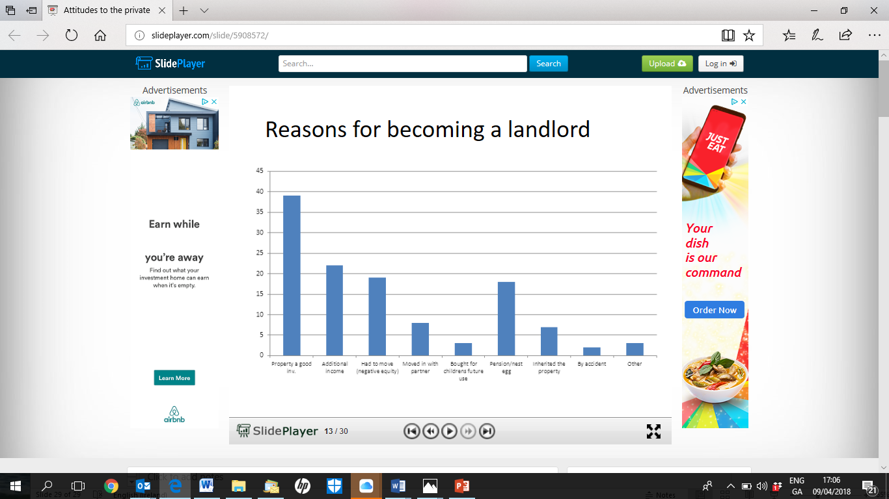
Top 7 Reasons for becoming a Landlord
Property is a good Investment (38%)
Additional Income (22%)
Had to move / neg. equity (18%)
Pension (17%)
Moved in with partner (8%)
Inherited the property (7%)
ESRI Survey

Slide 21
ICS Mortgages Proposition

Slide 22
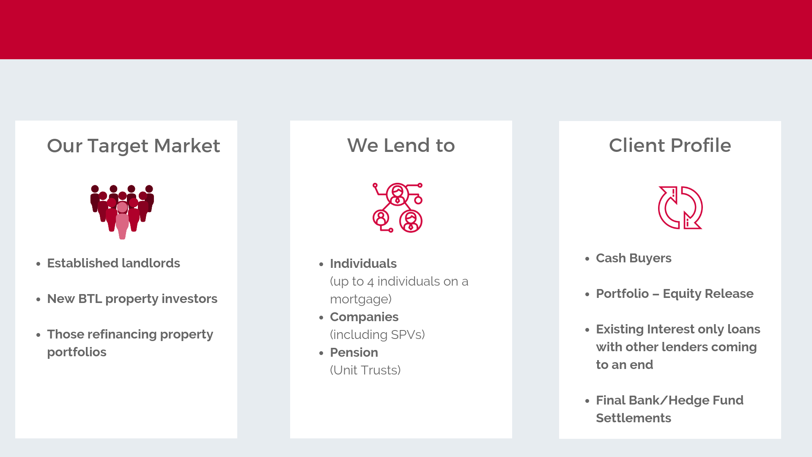

Slide 23

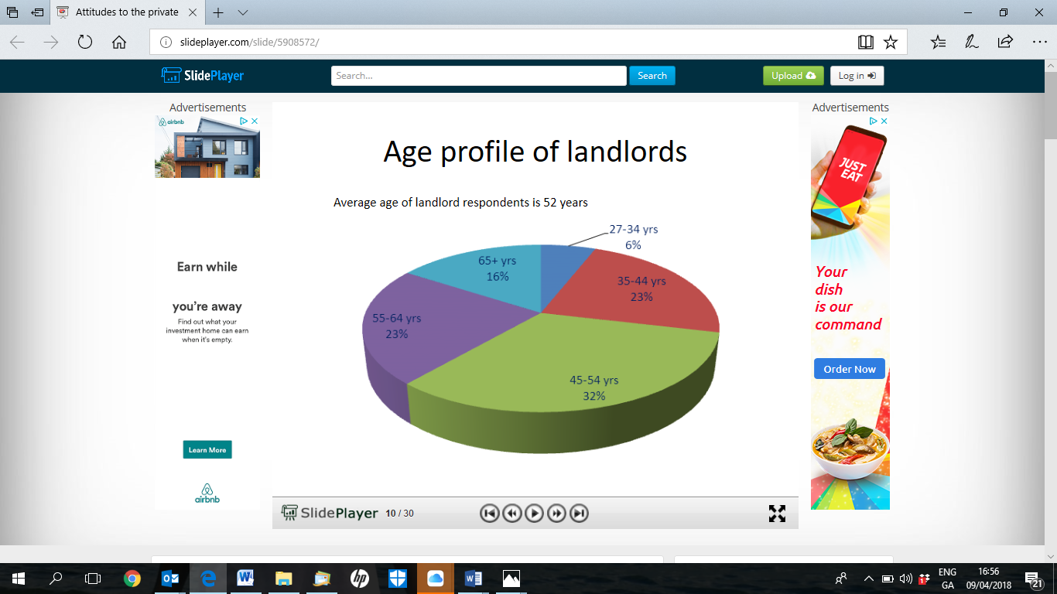
Age Profile of Landlords – Market v’s ICS Mortgages
MARKET
The average age of our borrower 52 years
ESRI Survey

Slide 24
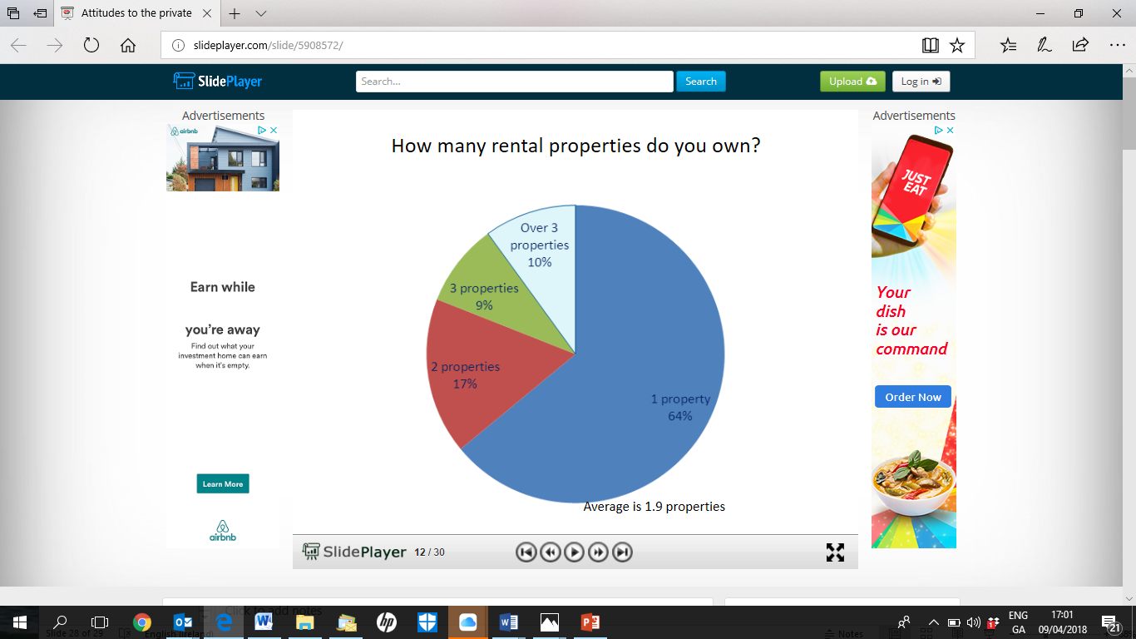
No. of investment properties – Market v’s ICS Mortgages
MARKET
85% of our customers have 3 or more investment properties
ESRI Survey

Slide 25
Pension (Unit Trust) Mortgage
You can acquire a Buy-to-Let property in a tax efficient manner through your pension.
Choice and diversity - it is an additional asset class or vehicle of investment for your pension funds.
You will not pay tax on rental income and you don’t pay Capital Gains Tax on disposal.
Product Features
  Non-Recourse Lending
  15-Year Capital & Interest option or 15-Year Interest Only option
  Loans up to €500,000

Slide 26
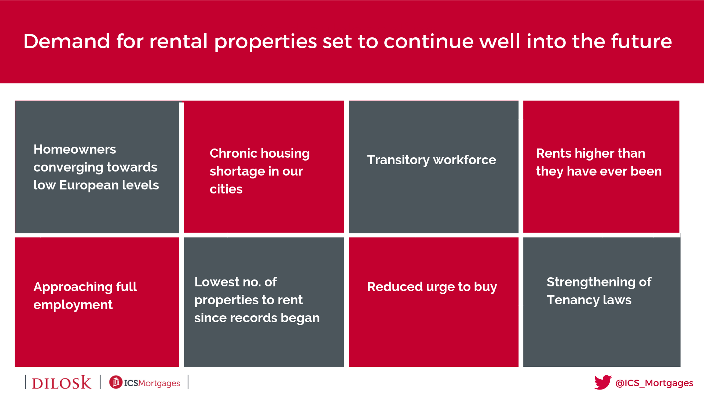

Slide 27
THANK YOU !
For further information, contact:
For further information, contact:
Cathal Parkes , Fergus McGrath or Joey Murray
061 317260 ; 01 693 1330
cathal@FCFS.ie ; fergus@fcfs.ie ; Joey@fcfs.ie
Dilosk Dac, trading as Dilosk and ICS Mortgages, is regulated by the Central Bank of Ireland

