Slide 1
Protecting your clients business and their legacy

Slide 2
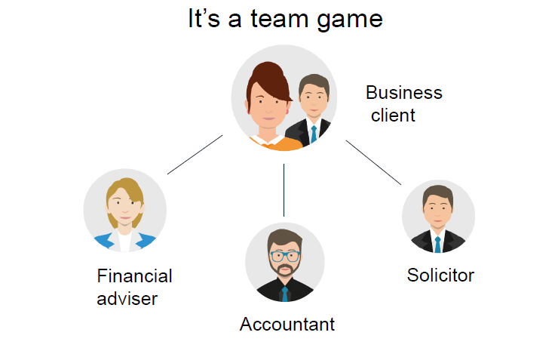
Professional Collaboration

Slide 3
Working together to provide clients with the best advice
Understanding our clients and their objectives
We can then assess and establish the risks
Explain the risks to clients and likely outcomes
Create a solution
Implement the solution by working together

Slide 4
Protecting our clients legacy
Business Protection
Retirement Relief
Business Relief
Succession Strategy
Inheritance Planning

Slide 5
Inheritance Planning
Children can only inherit €320,000 from parents tax-free
Anything in excess of this is taxable at 33%
€460,000,000 was paid in Capital Acquisitions Tax in 2017 – revenue.ie
Thresholds have been greatly reduced in last 10 years
2008
Group 1
€521,208
2018
Group 1
€320,000

Slide 6
Section 72 Whole of Life
Estate Value: €1,800,000
55 year old widow with two children
€320,000 threshold per child
In this scenario, by setting up a Section 72 whole of life policy for just 0.48% of the value estate in premiums per year, her children’s CAT liability of €382,800 can be paid with the proceeds of the policy

Slide 7
Main Benefits of a Whole of Life Policy
Life Assurance policy that pays out benefit in the event of death
Guaranteed premium and benefit for the rest of the persons life
Revenue approved to protect beneficiaries CAT liability

Slide 8
Product Enhancements
Protected Cashback*
Guaranteed refund of 70% of premiums paid after 15 years*
Protected Cover*
Lower guaranteed benefit and no more premiums to be paid*
Client will know from the start the maximum they’ll ever pay in premiums
Section 72 life insurance policy typically used to pay inheritance tax. However, can also be used to help pay tax due on the inheritance of a Approved Retirement Fund

Slide 9
Section 72 to pay tax on ARF
Client leaves 100% of ARF to their son
On inheritance their son will a 30% income tax liability
In this scenario, by setting up a whole of life policy for just 0.66% of the value of their ARF in premiums per year, their son’s income tax liability of €300,000 can be paid with policies proceeds

Slide 10
Protecting our clients legacy
Business Protection
Retirement Relief
Business Relief
Succession Strategy
Inheritance Planning

Slide 11
Questions to ask yourself
In the event of death of your business partner
What will happen to their shares in the business?
Will the deceased’s family join the business?
What will be the impact of such a new inexperienced partner?
In the event of your death
What will happen to your shareholding?
Are your spouse/children in a position to take your place in the business?
How will your business partners react?
How will your family survive financially?

Slide 12
We are asking you to ask your clients “How would your business cope?”
In the event of the death of your business partner
The untimely death of a partner in a firm can have serious financial implications for the continuing partners.
In fact, under the provisions of the Partnership Act 1890, the deceased Partner’s share of the business automatically becomes the property of their estate.

Slide 13
Solution: Partnership Insurance
Put the measures in place now to safeguard the future of your firm
Helping enable the companies financial stability
Surviving partners have funds to buy the deceased’s share in the firm without having to resort to borrowing or selling assets
Surviving partners retain control of the business

Slide 14
Case Study: XYZ Partnership
Three partners: Alan, Barry and Ciara
Firm is currently valued at €1,800,000
Value of each partners share €600,000
Want to ensure that in the event of death that the deceased’s estate is financially compensated for their share in the firm
That the partnership is not dissolved and that the business can continue to operate
That the surviving partners remain in full control of the company

Slide 15
XYZ Partnership
All three Partners in XYZ have decided to arrange Partnership Insurance.
A number of things to consider:
Option 1: Life of a Another
Each Partner in the firm insures each of their fellow Partners, for the amount they would need to buy back the deceased Partner’s share of the business.
Option 2: Own Life in Trust
Each Partner insures their own life for the value of their share of the firm, with the policy being written under a Declaration of Trust for the benefit of the surviving Partners. On the death of a Partner the remaining Partners will receive a proportion of the Life cover in place. This is then used to buy back the deceased Partner’s share of the business.

Slide 16
“How would their Company cope?”
The sudden death of a shareholder in a private limited company can cause problems for both the surviving shareholders and the family of the deceased shareholder.
For example the surviving shareholders could lose control of the business as they may find themselves working with the deceased’s family
Life assurance can provide a solution to these problems by providing liquid capital on the death of a shareholder

Slide 17
Solution: Shareholder Protection
Shareholder protection is life assurance which is taken out to protect both business owners and their families in the event of the death of one of the business owners.
Life cover is effected on the shareholders.
The proceeds of this life cover are intended to enable the surviving owners to buy back the share of a business that belonged to the deceased shareholder.
This enables the surviving shareholders to retain control of the business, and it provides a fair price for the shares to the deceased’s family.
An agreement is put in place to ensure that this is what happens.

Slide 18
Case Study: ABC Ltd
Limited Company want to ensure that in the event of a sudden death of a shareholder that the surviving shareholders remain in control of the company.
Options Available:
Personal Shareholder Protection
Corporate Shareholder Protection

Slide 19
ABC Limited
All four shareholders in ABC Ltd have decided to arrange Shareholder Protection
A number of things to consider:
Option 1: Personal Shareholder Protection
The shareholders enter into a personal legal agreement with each other to "buy out" a deceased shareholder's shares in the event of his death
To provide the funds to fulfil their personal obligation under the legal agreement each shareholder personally effects life assurance cover which is payable to the surviving shareholders on his death
The surviving shareholders can then use the proceeds of the life assurance plan to "buy out" the deceased's next of kin in line with the legal agreement

Slide 20
ABC Limited
Option 2: Corporate Shareholder Protection
The company enters into a put / call legal agreement with each of its shareholders to buy back shares from their personal representatives in the event of death
The company takes out a life assurance plan on each shareholder, to provide funds to enable the company to fulfil its obligation under the legal agreement
In the event of death, the proceeds of the life assurance plan are payable to the company to be used to buy back shares from the deceased's next of kin in line with the legal agreement
The major advantage of the "Corporate" arrangement is that the cost is borne totally by the company because the plan proceeds are for the benefit of the company - with no "benefit in kind" implications for the individual shareholders

Slide 21
Protecting your Key Employees
Do your clients have a key employee whose death or serious illness would impact the success of their business?
Do they have a key employee who would need to be replaced urgently if they died or suffered a serious illness?
Solution: Keyman Insurance

Slide 22
Summary:
Very brief overview of how to protect your clients
No two set ups are the same
Tax is a complex subject
Advice is the key
First Choice can help you and your clients

