Slide 1
SELF DIRECT your own INVESTMENTS
Our APPROACH…

Slide 2
I’d like to touch on
Introduction to Self Investment – within the Pension environment……………
How does the Self administrated structure work & Regulatory requirements
What can FCFS do for you?
How can we help your client take more control?
Introducing Alternative Investment Options

Slide 3
A changing market…
2003 Pensions Ombudsman
2008 Registered Administrator
2011 ARF Options
2002 PRSA
1967 ITA
TCA 1997
FA 2006 €5m PFT
2010 Trustee Training
1972 FA
1969
Today
Pensions Act 1990
FA 2006 Imputed Dist
Pensions Levy
1999 ARFs
1998 NiPPI
FA 2008 €150,000 cap
2010 National Pensions Framework
2002 - €254k cap / new cont rates
2005 IORPS

Slide 4
A changing market…
AMRF & SCP Christmas Bonus
Imputed distribution extended to PRSAs
Super Imputed Distributions
ARF taxation on death
Pension Simplification
Today
Future
Get out of jail for public servants who suffer chargeable excesses
New facilities to pay chargeable excesses
SFT increased?
Automatic Enrolment

Slide 5
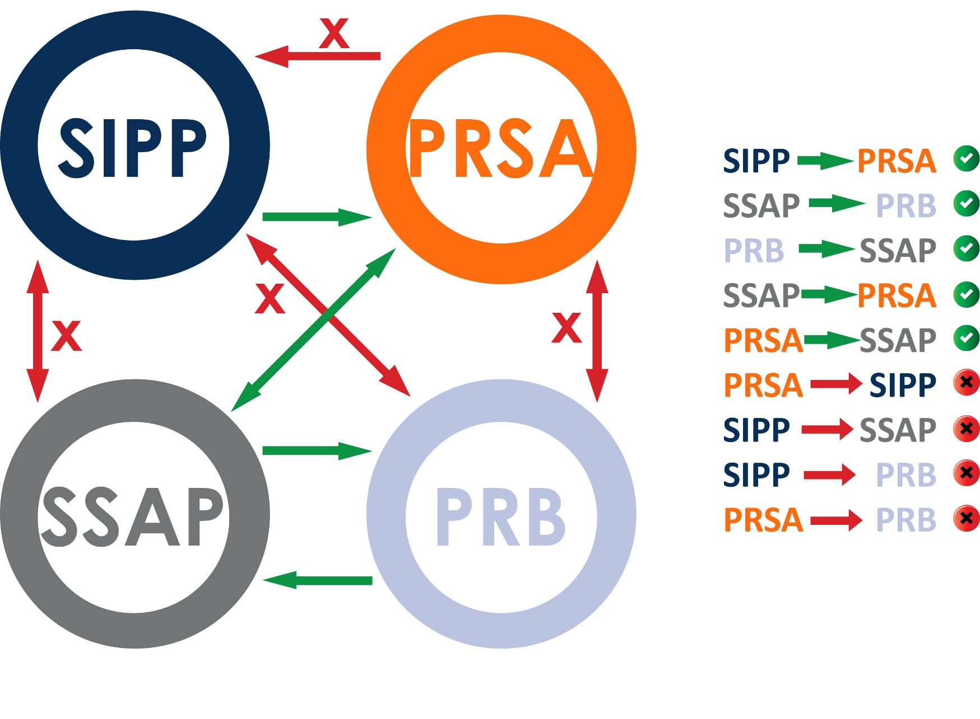
Pensions gone mad!!
When you can and can’t transfer your pension fund
Self directing is always an option!
BUT Pension Authority must be adhered to

Slide 6
How does the Self administrated structure work Client Takes Control by SELF DIRECTING
What structure is to be used:
SSAP / PRB / PRSA / ARF
Client decides what to invest in
Client becomes the FUND Manager
Tax Exempt Investment Vehicle
Layer of Protection
2 signatures – Member & Pensioneer Trustee
trustee will always act in the best interests of the member
Very common action post 2009 to keep creditors away

Slide 7
What are the tax benefits available?
Company pension contribution….qualifies for…….Corporation Tax Relief
Members personal contributions ……qualify for…. Income Tax Relief
Growth within the fund is free from CGT & IT…….Deposits are free from DIRT
(4) tax reliefs
TFCLS is available at retirement……up to €200k
TFLS is payable on death before retirement

Slide 8
How does a self administered structure work?

Slide 9
Pensioneer Trustees – Who administrator your fund
Small Self-Administered Pension (SSAP) only
Pensioneer Trustee will manage your SSAP…..
Regulated by the Pension Authority
IN ADDITION
Self-directed ARF only
Administrator must be a Qualifying Fund Manager (ARF only)
In order to distribute PRSA, PRB & ARF facilities, the administrating company
must be a MiFID Approved Firm
If you require Loan Note or property syndicates facilities, your administrator
firm must have an AiFMD (Approved investment & Fund Manager Directive)

Slide 10
What can we do for your client
Advise the client on the appropriate “structure” to be used
Self-employed or Company Director
Retirement Planning……………extracting funds @ NRA
Estate/Succession Planning……
Advise the client on the appropriate “investment” options
Understanding Risk & Volatility
Asset Classes & Diversification
Charges and AMC
Support your client on the journey
Quarterly Reporting
Provide Trustee services

Slide 11
Authorised v Unauthorised Investments Investments

Slide 12
Everyday investment options….
Available to everyone!!
Lifestyle strategies
Managed Funds
Direct Equities Funds
Property Funds
Deposits & Cash
Government & Corporate Bonds
Ethical Investments options
Alternative Investment Strategies

Slide 13
ADDITIONAL Investment Options through Self Administration
Physical Property both Residential & Commercial
Property Syndicates
Direct Shares
Loan Notes and Partnership Syndicates
Structured options
Short term & long term options
Alternative Investments
Renewables
Commodities

Slide 14
Purchasing a Property - What to consider
Do I have enough Cash to complete the transaction
Liquidity is a key component
Stamp Duty
Legal Fees
Purchases Costs
Enhancement Expenditure
Annual Management Charge (Annually)
DO I NEED TO BORROW
RENTAL INCOME must be lodged to the SSAP Bank account
REVENUE are concentrating on this area as we speak!!

Slide 15
Borrowing to purchase PROPERTY through a SSAP & PRSA only
The term of the loan can be no greater than 15 years
The loan can only be offered on a capital and interest basis!
Interest only may also be available
The loan must be offered with recourse to the property only (no recourse to the rest of the pension fund)
Loan to Value 50:50
No personal guarantees can be accepted
Arms length transactions only
LIQUIDITY is a very important element
NOTE: One cannot borrow through an ARF or a PRB!!

Slide 16
DIVERSIFICATION Alternative Investment Options sourced by First Choice
Ethical investment in renewable energy
LOAN NOTE INSTRUMENTS
STRUCUTURED PRODUCTS
MANAGED FUND Platforms
E.g. Conexim
Fund Administrators
Morning Star
Dimensional
Blackrock
Multi others…….e.g.
Standard Life Aberdeen
7,000+ funds
Alternative - GOLD EFT!!
Property Specific
Asset Backed
E.g. Short term loan facility
Interest 8% pa over 12 months
Nursing Home facility
Non-Connected person(s)
Wealth Options
BCP Asset Management
Blackbee
Broker Solutions
Capital protection offered
Fixed term, fixed return, return dependent on indices performance

Slide 17
DIVERSIFICATION Alternative Investment Options sourced by First Choice
Property related
Loan Note Instrument(s)
STRUCTURED
Protected Index 7
CAPEL ST., DUBLIN 1
Asset Back Loan Note
5 year investment
Annual Coupon 5.5% paid
+ 25% NAV uplift
_______________________
CITY QUARTER, Cork City
Asset Back Loan Note
2 year investment
Annual Coupon 5.0% paid
2 year term
5% return over 2 years
2.5% pa
90%/95% capital protection at maturity
European Index exposure
_________________________________
CGT tax treatment
Utilitsing the CGT credit of €1,270 allows for a full 5% return with no tax payable
E.g. €25,400 or €50,800 joint names utilising €2,540 CGT credits

Slide 18
DIVERSIFICATION Alternative Investment Options sourced by First Choice
Ethical investment in renewable energy
GREENMAN
DIRECT PROPERTY
RENEWABLE ENERGY
YOUR CLIENT chooses the Property
Residential
Commercial
CAPITAL grows TAX FREE
RENTAL INCOME accumulated TAX FREE
Transactions only with UNCONNECTED PERSONS
All purchase costs can paid from within the fund
Liquidity must be considered
German Property Fund
Food Retailers
Regulated by CBoI
Annual return paid of 5.5% pa
Paying distributions quarterly
Targeting additional capital growth of 2.5% per annum
Solar 21 – Irish based Co
Ethical Investment in renewable energy
Targeting 10.5% pa return
Exposure to FX – GBP/Eur
UK Government –backed Revenue streams

Slide 19
FRANKED INVESTMENT INCOME Non Pension related investment option
Energy For Waste -------- Corporate Investment Opportunity
Irish Registered Co. investing in Irish Registered Co.
€100,000 on deposit
€100,000 in a Corporate Bond
€100,000 in EFW21
PAY 25% TAX on return
PAY 25% TAX on return
PAY 0% TAX on return

Slide 20
SUMMARY
Self Directing
Self Investing
is an option
You take control
Many options
We can guide your client to be invested in something that they feel comfortable with.

Slide 21
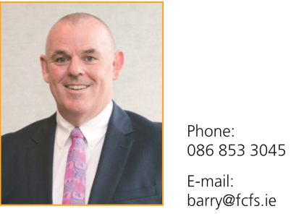
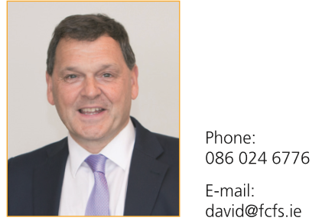
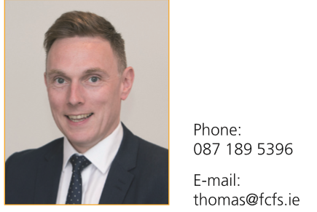
Meet the Team
Barry White
Jim Wallace
David
Sommerville
Thomas
Fitz-Gough

